Slide 1




TunedIn:
Leeds
Intune Mac Management
Neil Johnson

Slide 2



Agenda Slide
What have we been up to?
Settings Catalog and DDM
What’s next?
Notes:
Why Choose Microsoft Intune for macOS management?
Enterprise Mac Management
Enrolling devices
Managing Identity
Security
Device configuration
Application deployment
Resources

Slide 3





Microsoft Intune
Modern endpoint management powered by the Microsoft Cloud
Microsoft Intune
Simplify and consolidate endpoint management
Cut cost and complexity by shifting to the cloud, unifying endpoint management and security tools in one place.
Co-managed
Cloud-managed
Fortify Zero Trust security
Mitigate threats and improve compliance across all devices by protecting users, devices, apps, and data.
Corporately owned
Unenrolled and BYO
Increase satisfaction
Proactively manage better user experiences while driving operational efficiency with AI and automation.
Core and advanced endpoint management
Integration with Copilot for Security
Notes:
Slide Objective: One solution for both core and advanced endpoint management needs.
Talk Track:
Microsoft Intune is an industry-leading unified endpoint management (UEM) solution that organizations depend on to ensure their devices, operating systems, and apps are up-to-date, protected, and performing.
Our unified endpoint management offers you easier management and powerful data and device protection, all at a lower total cost of ownership by consolidating your endpoint management and security vendors and optimizing performance across devices.
Within Intune you can manage on-premises, cloud, mobile, desktop, and virtual endpoints across platforms, including Windows, macOS, iOS, Android, and Linux operating systems.
Intune helps you prioritize the user experience by empowering your IT teams to deliver the best possible endpoint experience through zero-touch deployment, flexible, nonintrusive mobile application management, and proactive recommendations based on Microsoft Cloud data.
Next Slide

Slide 4

How Microsoft Intune manages Macs
Unified cloud-native endpoint management delivering scalable, reliable, and secure macOS experiences
Platform-first
MDM+
Secure productivity
Community tooling
Native apps
Day zero support for Mac MDM
Supports next-gen Declarative Management
Intune agent enhances native Mac MDM stack
Extended admin control
Microsoft 365
Conditional Access
MFA
Defender
Open-source commitment
Contribute to community
Compatible with community projects
Notes:
Slide Objective: Provide the customer with our strategy for macOS management and how we approach our development.
Talk Track:
Platform First: If Apple builds a management capability into macOS, we will build support for it. We will also support every major and minor build of macOS on launch from Apple.
MDM+: Where our customers have requirements that can’t be met by the macOS management capabilities, we’ll use our Intune Agent to achieve those tasks. Examples are things like DMG support and scripts.
Secure: Intune is part of the EM+S suite, which includes products to secure identity, data, and devices. It’s not just about MDM management.
Community: The Mac community has a rich legacy when it comes to maintaining their own tooling. Intune is committed to supporting these apps and tools. We’ll be making more improvements in this space over time, too.

Slide 5
What have we been up to for the last year?

Slide 6
Intune macOS features shipped in last 12 months
What we’ve been up to since we were last here…
May-July 23
Aug-Oct 23
Nov-Jan 24
Feb-Apr 24
DMG support
Pin web clips to dock
New wipe actions
Settings Catalog+
Defender policy enhancements
Settings Catalog+
Defender policy enhancements
macOS Sonoma support
DDM software Update
Shell script run time limits
Defender policy enhancements
Settings Catalog+
Custom PKG support
Date picker for DDM software updates
DMG and PKG size increase to 8GB
Await final config
Custom PKG Pre + Post Scripts
Local account management
Settings Catalog+
Cloud PKI support + Remote Help
Platform SSO public preview

Slide 7
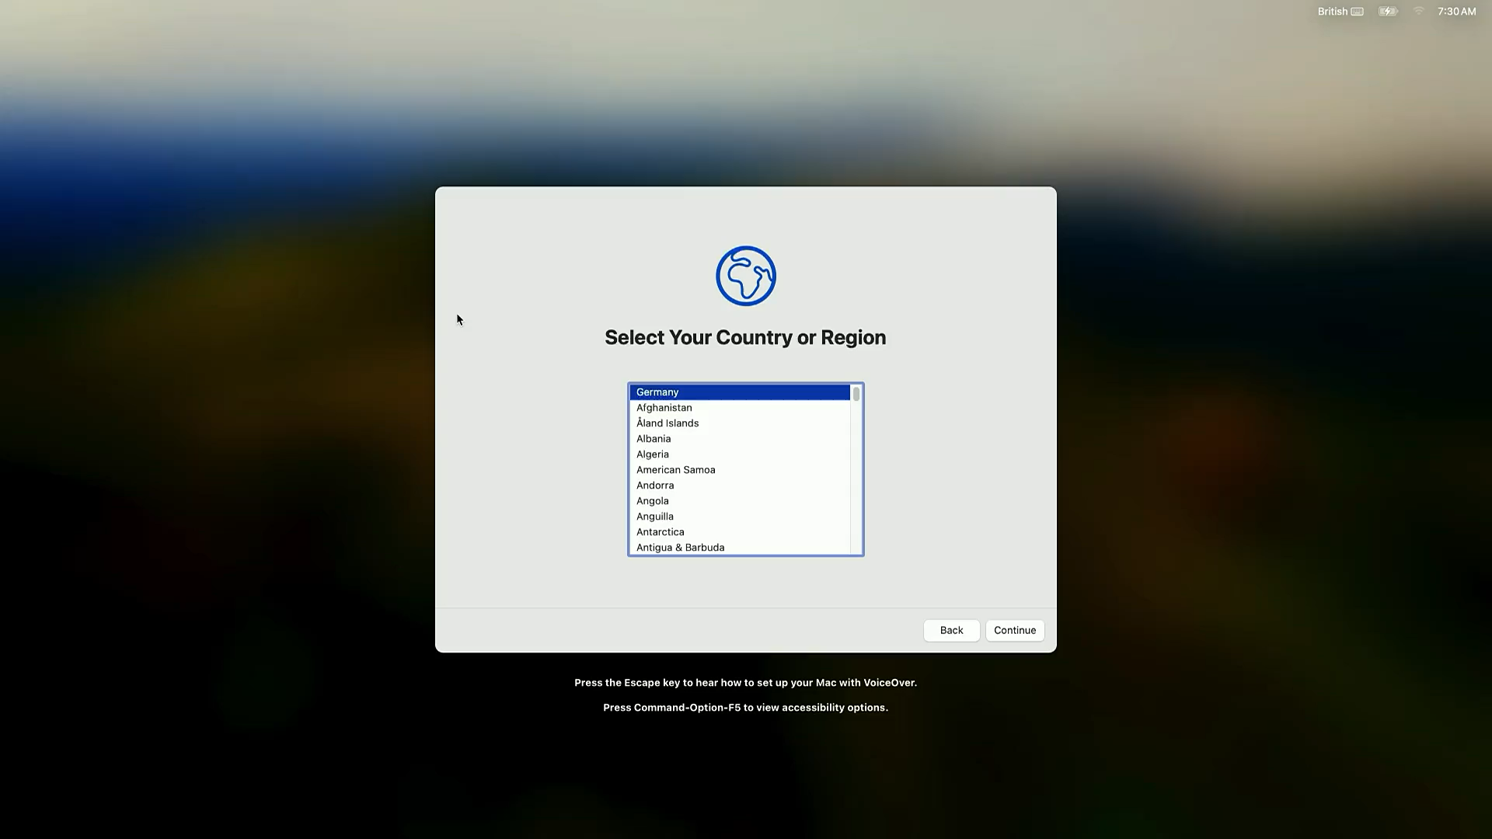

Slide 8
Settings Catalog+

Slide 9
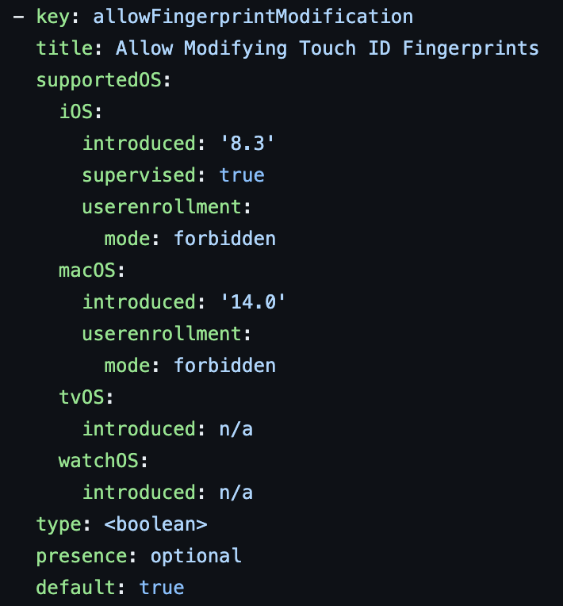
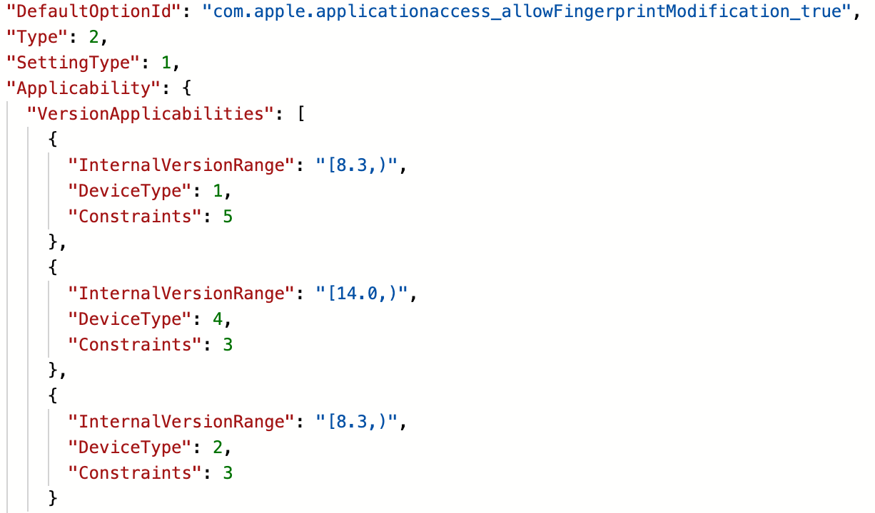
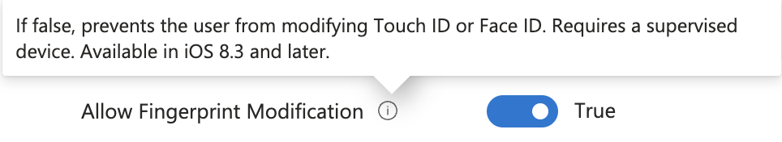
Apple Settings Catalog
2. Processed JSON understood by Apple Settings Catalog
1. Apple YAML

Slide 10
Device
MDM
Server
Device
DDM
Server
Device check in
Device check in
OS Update Scan
Fetch SU declaration
List Available OS Updates
Device activates SU configuration
Schedule OS Update (Download)
Not now
Status: Waiting
Device check in
Device notifies user daily, then hourly as deadline approaches
Schedule OS Update (Download)
OS Update Status
Status: Waiting
Downloading
OS Update Status
Downloading
Device downloads update
OS Update Status
Downloaded
Schedule OS Update (Install)
Status: Downloading
OS Update Status
Device prepares update
Installing
Status: Prepared
OS Update Status
Installing
OS Update Status
Deadline is met,
device installs update
Installed
Status: Installing

Slide 11

Settings Catalog+
Built for day 0 support
Apple payloads and commands
Microsoft app preferences
Built for the future
DDM declarations
Data reference architecture
Apple, WWDC 23

Slide 12
What’s next?

Slide 13
Intune Mac management roadmap
Onboarding
Configuration &
Conditional Access
App Management
Managed device attestation
Platform SSO – GA
Standard user management with LAPS
Enrollment Time Grouping
JIT compliance
Certs in user keychain
Custom compliance
Data-driven settings templates
DDM software update reports
Available custom PKG
Custom app detection
Notes:
JIT compliance CC. Available apps AM. User keychain certs CC. Custom compliance CC. MDE risk score CC? Managed device attestation O. Data-driven settings templates CC. Custom app detection AM. Available user actions CC. LAPS integration E. DDM apps support AM. PSSO – GA O

Slide 14
iOS 18 and macOS 15 | Beta
Both iOS 18 and macOS 15 Betas can be enrolled and managed by Intune today.
This means you can begin Beta testing now.
We don’t officially support Beta OS, but feel free to share your experience on the Microsoft Mac Admins Linked In group
Configuration Payloads
Settings Catalog has already had all Beta payloads imported (Expect to show in UI 2408)
Mac DDM software updates completely replaces need for MDM software updates!
Other stuff
Our planning cycle is happening next week
Andy Cerat Blog will flow a week or so after planning

Slide 15
Q&A
Thank you to our Sponsor
TunedIn:
Leeds

